Slide 1


Advanced Physics Lab Ⅱ
2020312141 Donghun Jung
2020311441 Yujin Chon
Raman Spectroscopy for

Slide 2
Outline
Outline
Intro
/Theory
Raman Spectroscopy
Graphene Phonon Mode
Experiment
/Results
GO, RGO, Graphite
Ti2CTx
Discussion
/Conclusion
Raman Spectrum

Slide 3

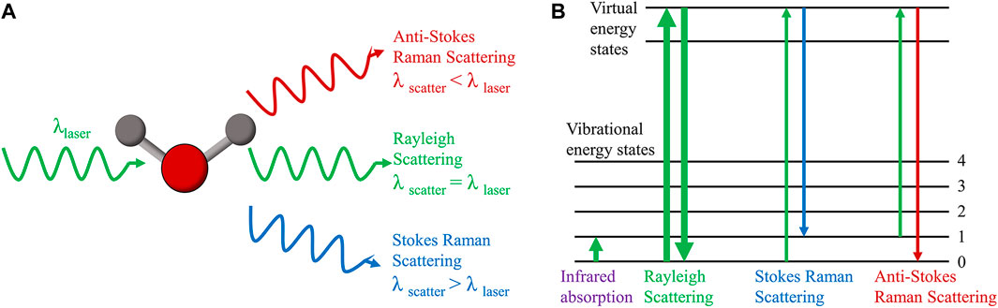
Raman Spectroscopy
Raman Shift
Raman scattering is inelastic photon scattering by matter. It is called Raman shift.

Slide 4
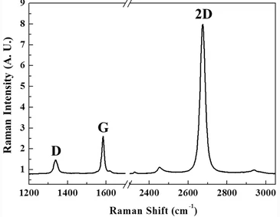


Raman Spectroscopy
Spectrometer
CCD

Slide 5
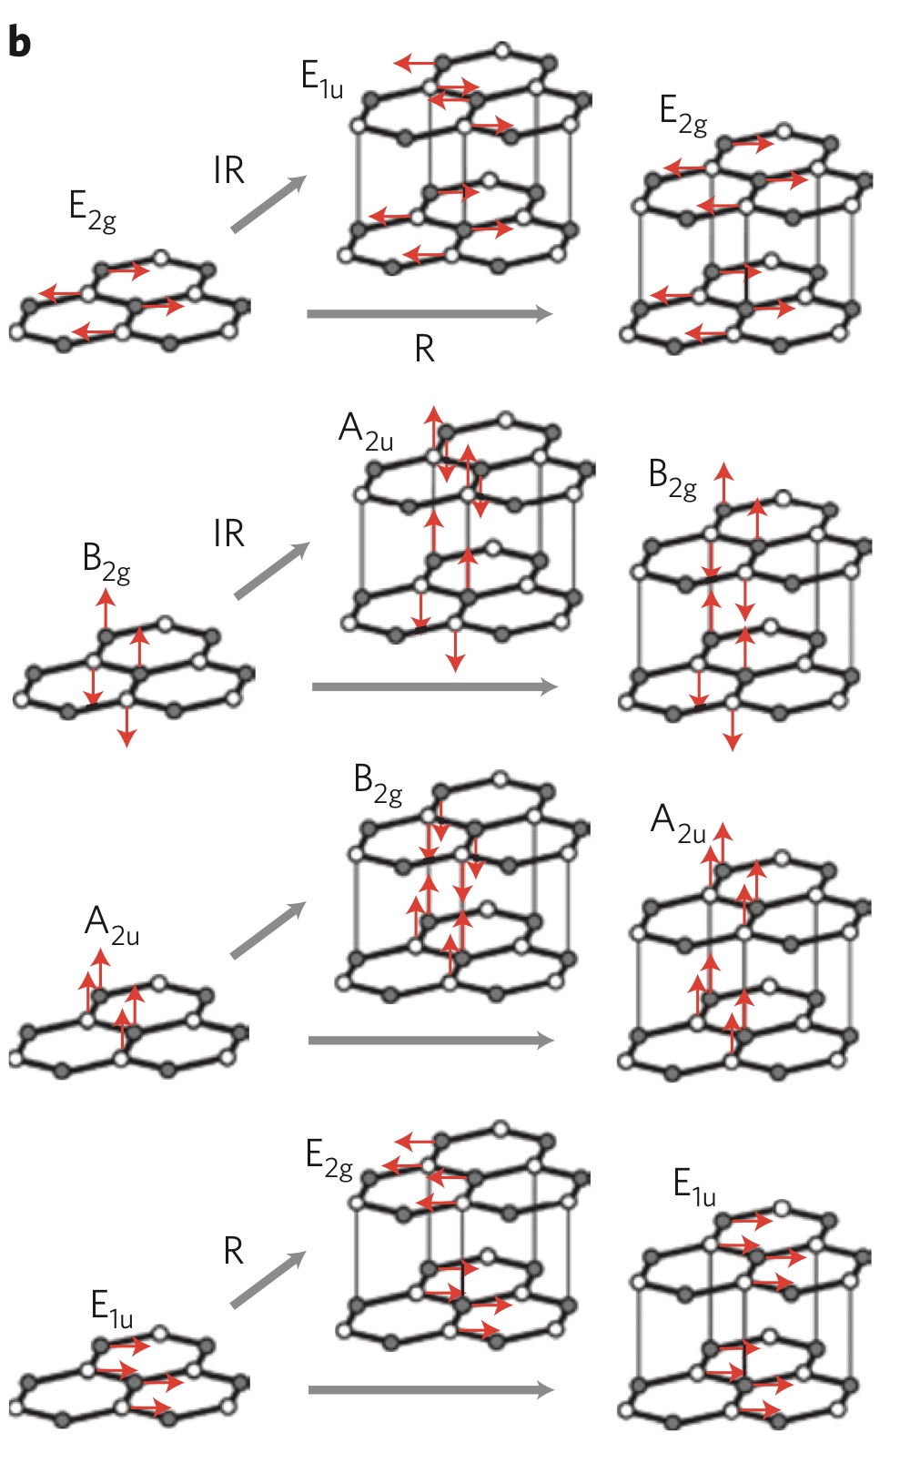
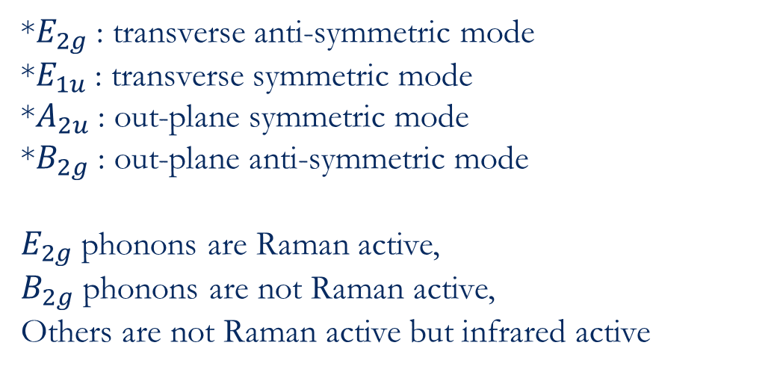
Graphene Phonon Mode
*$E_{2g}$ : transverse anti-symmetric mode
*$E_{1u}$ : transverse symmetric mode
*$A_{2u}$ : out-plane symmetric mode
*$B_{2g}$ : out-plane anti-symmetric mode
$E_{2g}$ phonons are Raman active,
$B_{2g}$ phonons are not Raman active,
Others are not Raman active but infrared active

Slide 6
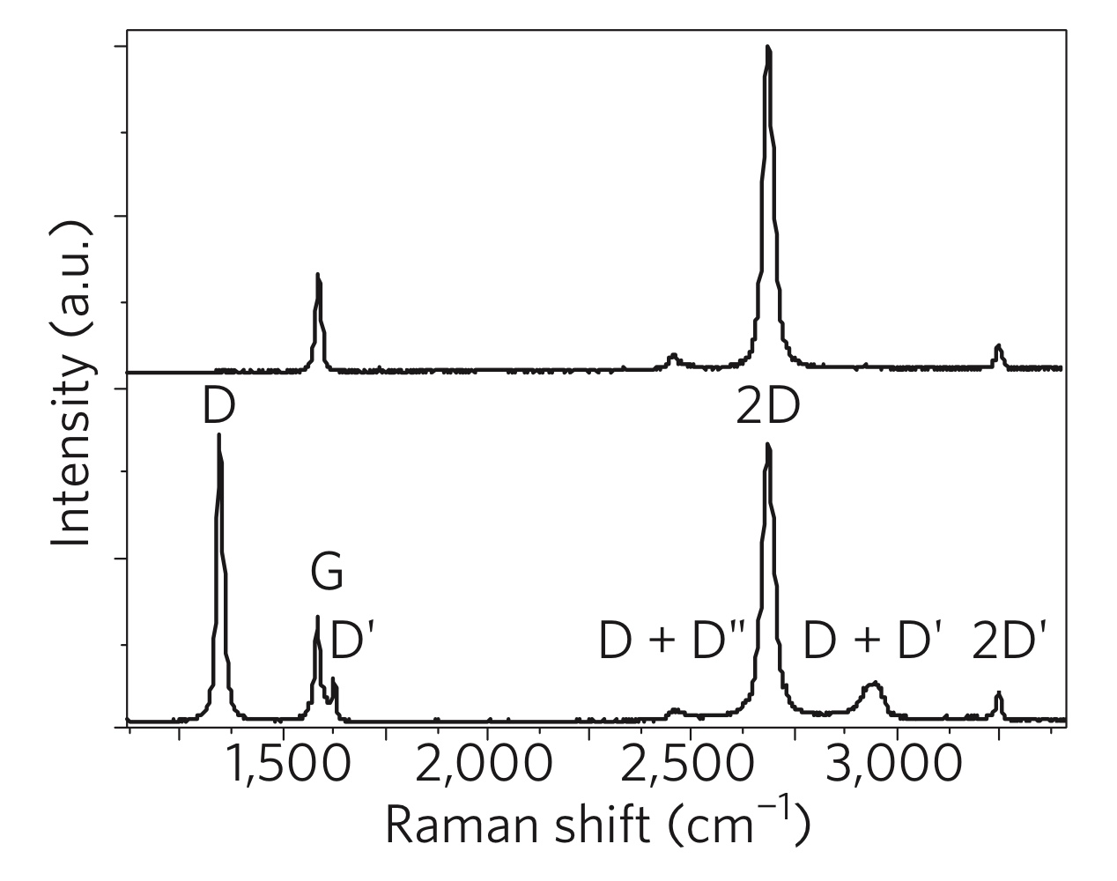
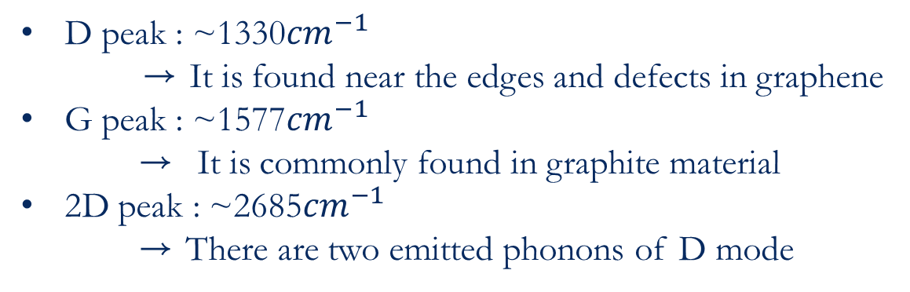
Graphene Raman Spectrum
D peak : ~1330${cm}^{−1}$
→ It is found near the edges and defects in graphene
G peak : ~1577${cm}^{−1}$
→ It is commonly found in graphite material
2D peak : ~2685${cm}^{−1}$
→ There are two emitted phonons of D mode

Slide 7
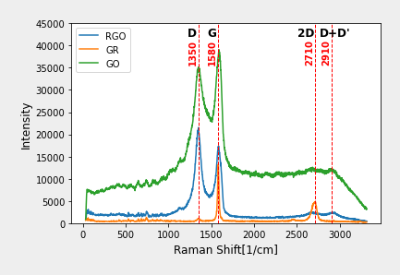
GO, RGO, Graphite

Slide 8
GO, RGO, Graphite

Slide 9
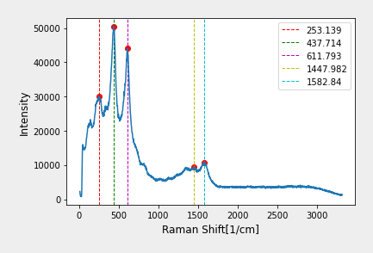
Ti2CTx

Slide 10
Raman Spectrum

Slide 11
Conclusion

Slide 12
References
[1]
[2]

Slide 13
Thank you

